Slide 1
CS213 Recitation 9
Notes:
Hello, everyone. In today’s recitation, let’s go over some knowledge points about Generic programming and JavaIO.

Slide 2
Generic Programming
Java IO
Notes:
These are the contents we will cover today.

Slide 3
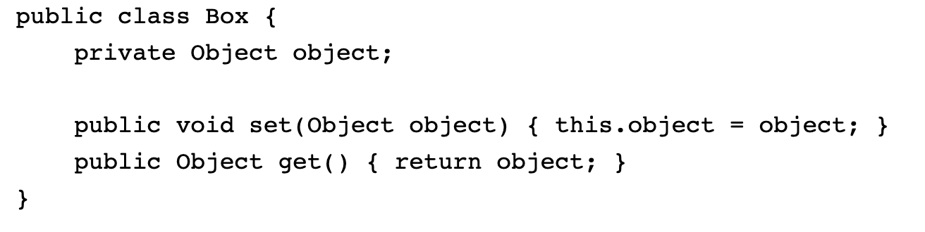
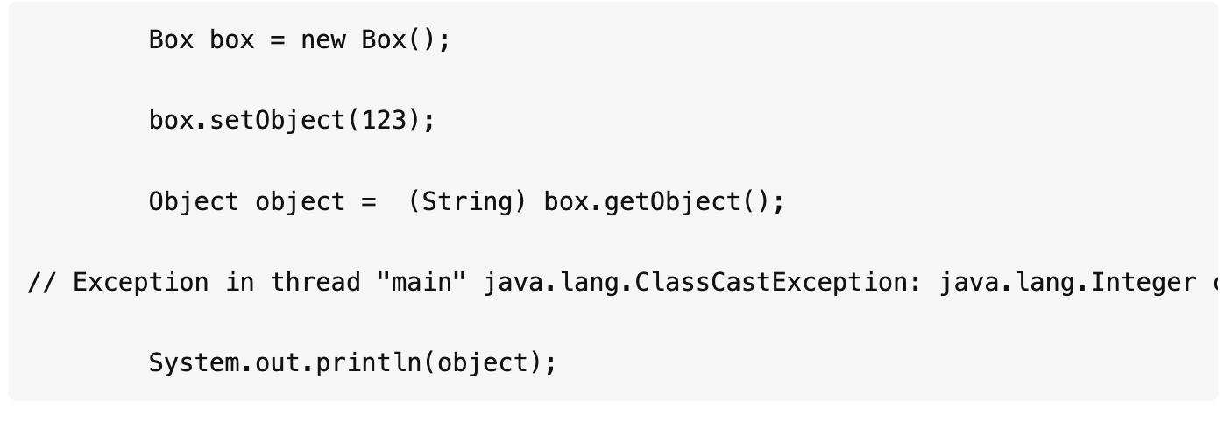
Generic Programming
A generic type is a generic class or interface that is parameterized over types.
The following Box class will be modified to demonstrate the concept, we will get an error when running the following code.

Slide 4
The generic version can be like this, then it won’t output an error:(By convention, a single capital letter such as E or T is used to denote a formal generic type.)
public class BoxT<T> {
// T means types
T object;
public T getObject() {
return object;
}
public void setObject(T object) {
this.object = object;
}
}
public static void main(String[] args) {
BoxT<Integer> b = new BoxT<Integer>();
b.setObject(123);
Integer integer = b.getObject();
System.out.println(integer);
}

Slide 5
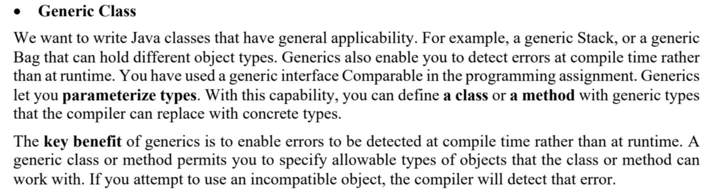

Slide 6
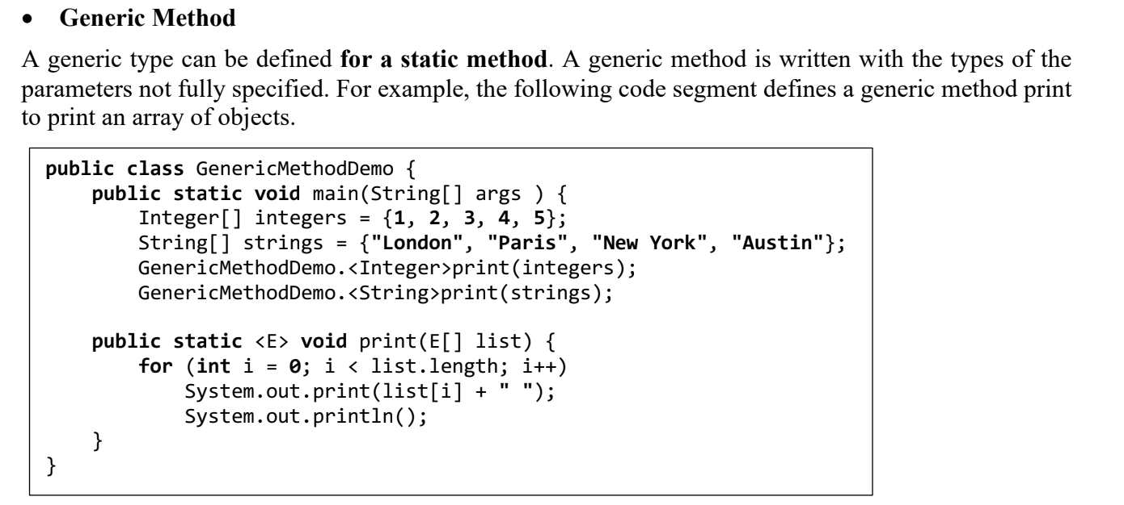

Slide 7
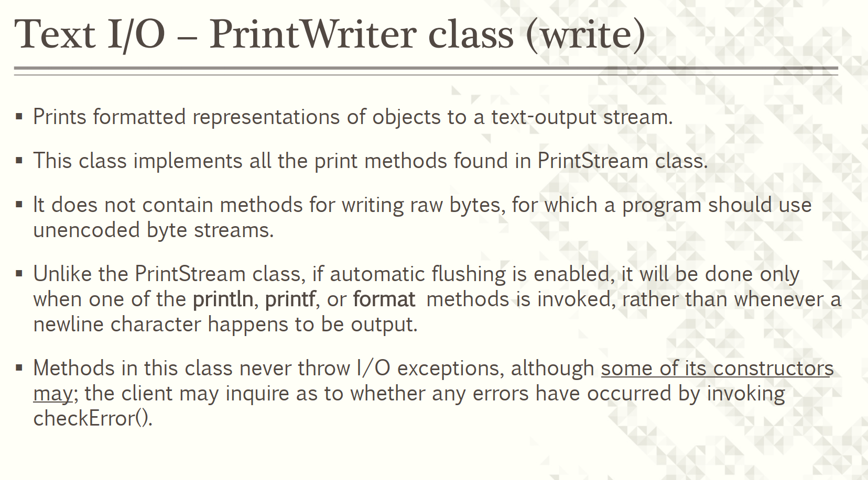

Slide 8
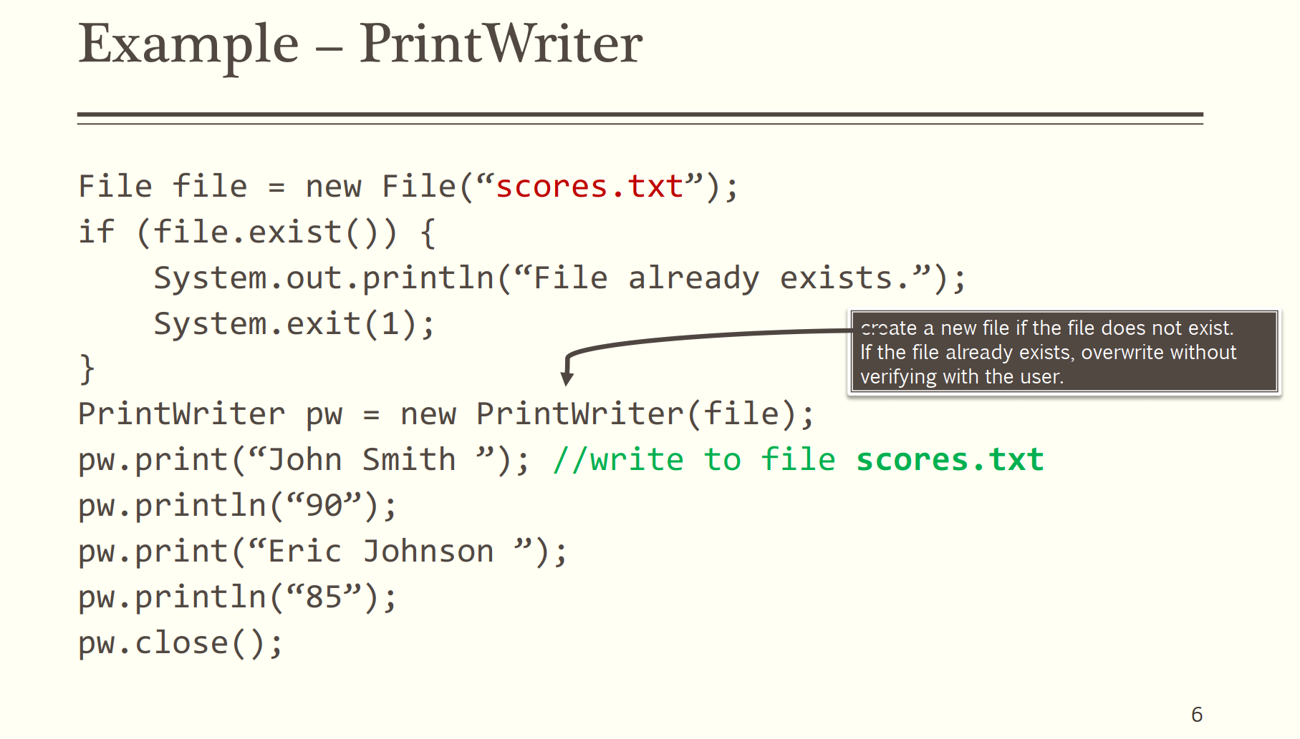

Slide 9
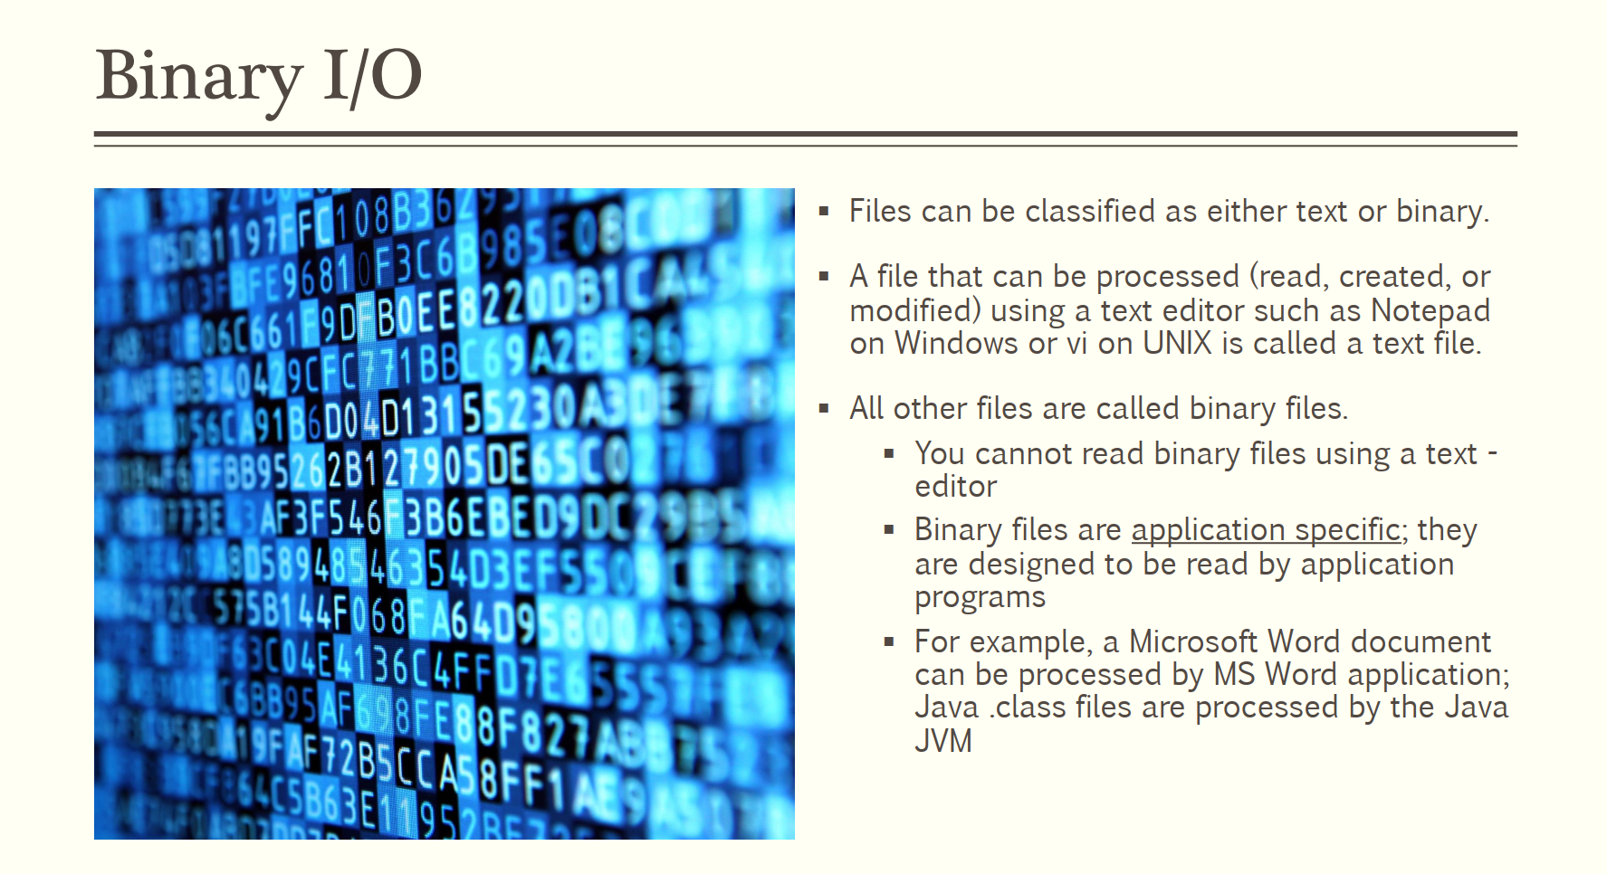

Slide 10
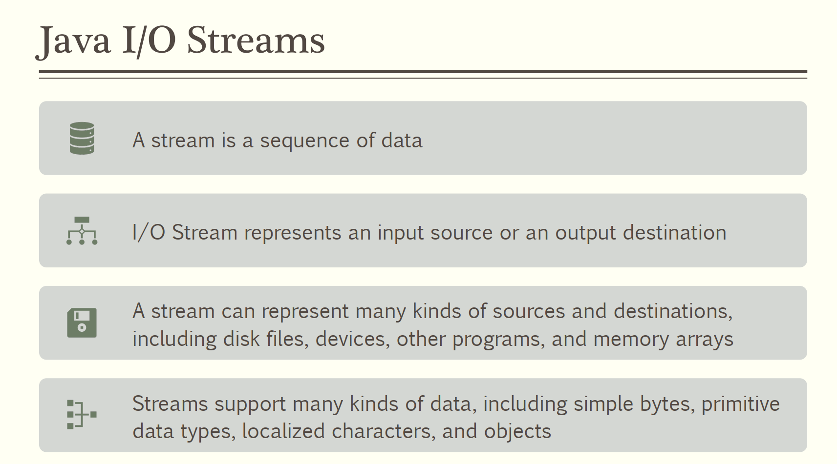

Slide 11
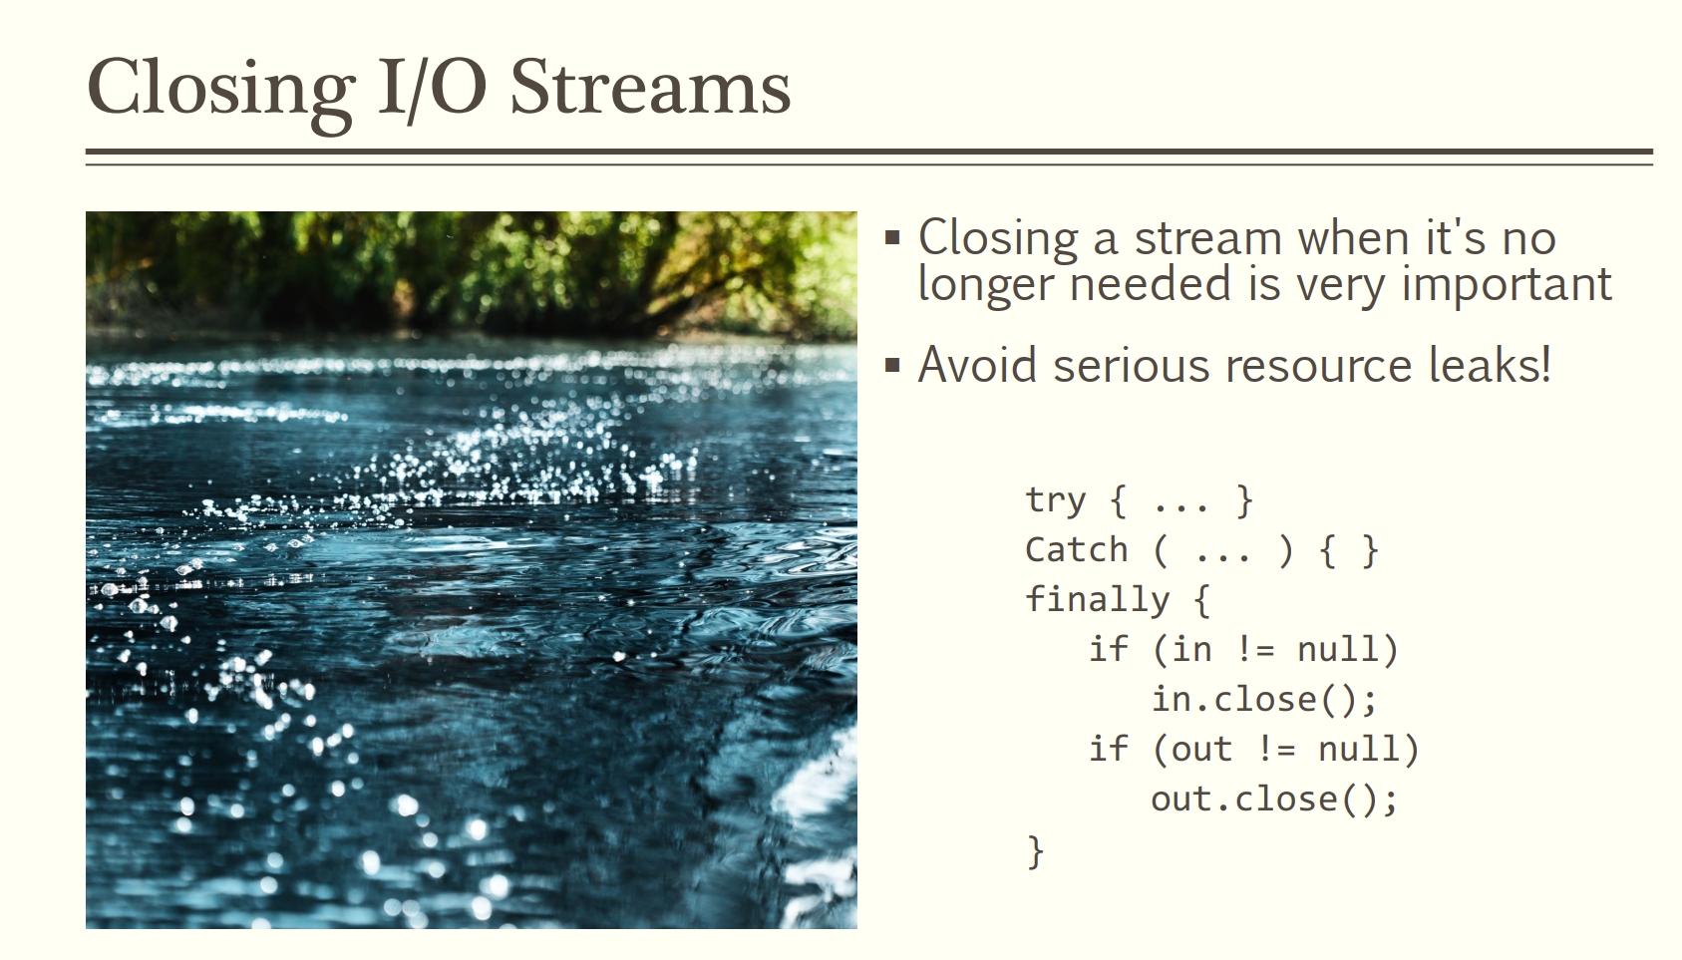

Slide 12
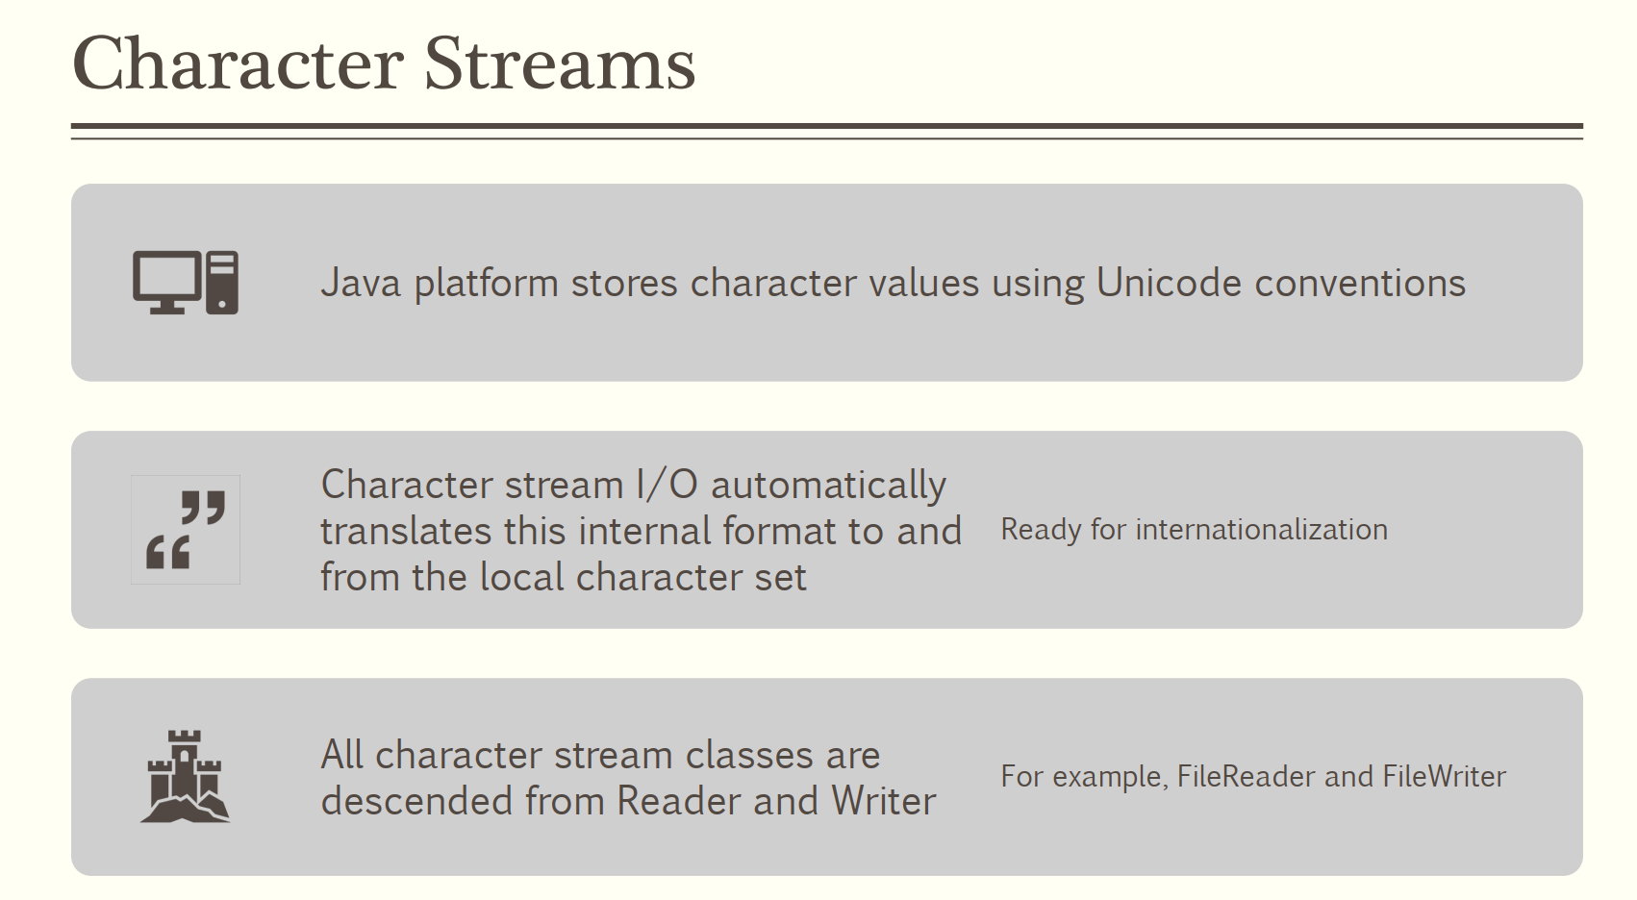

Slide 13
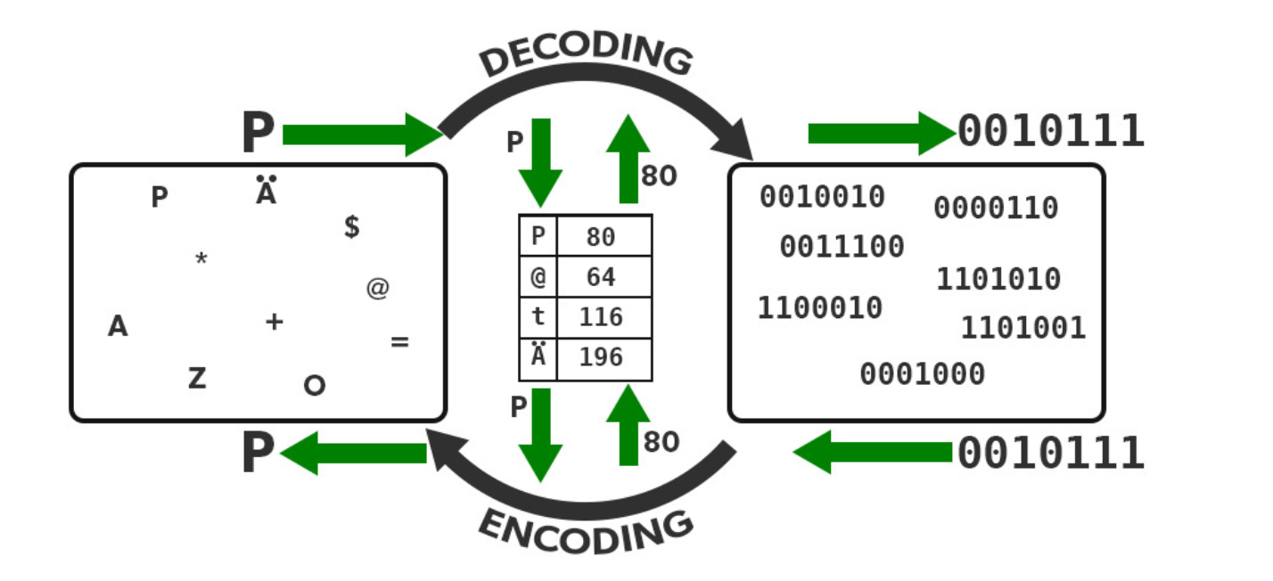

Slide 14
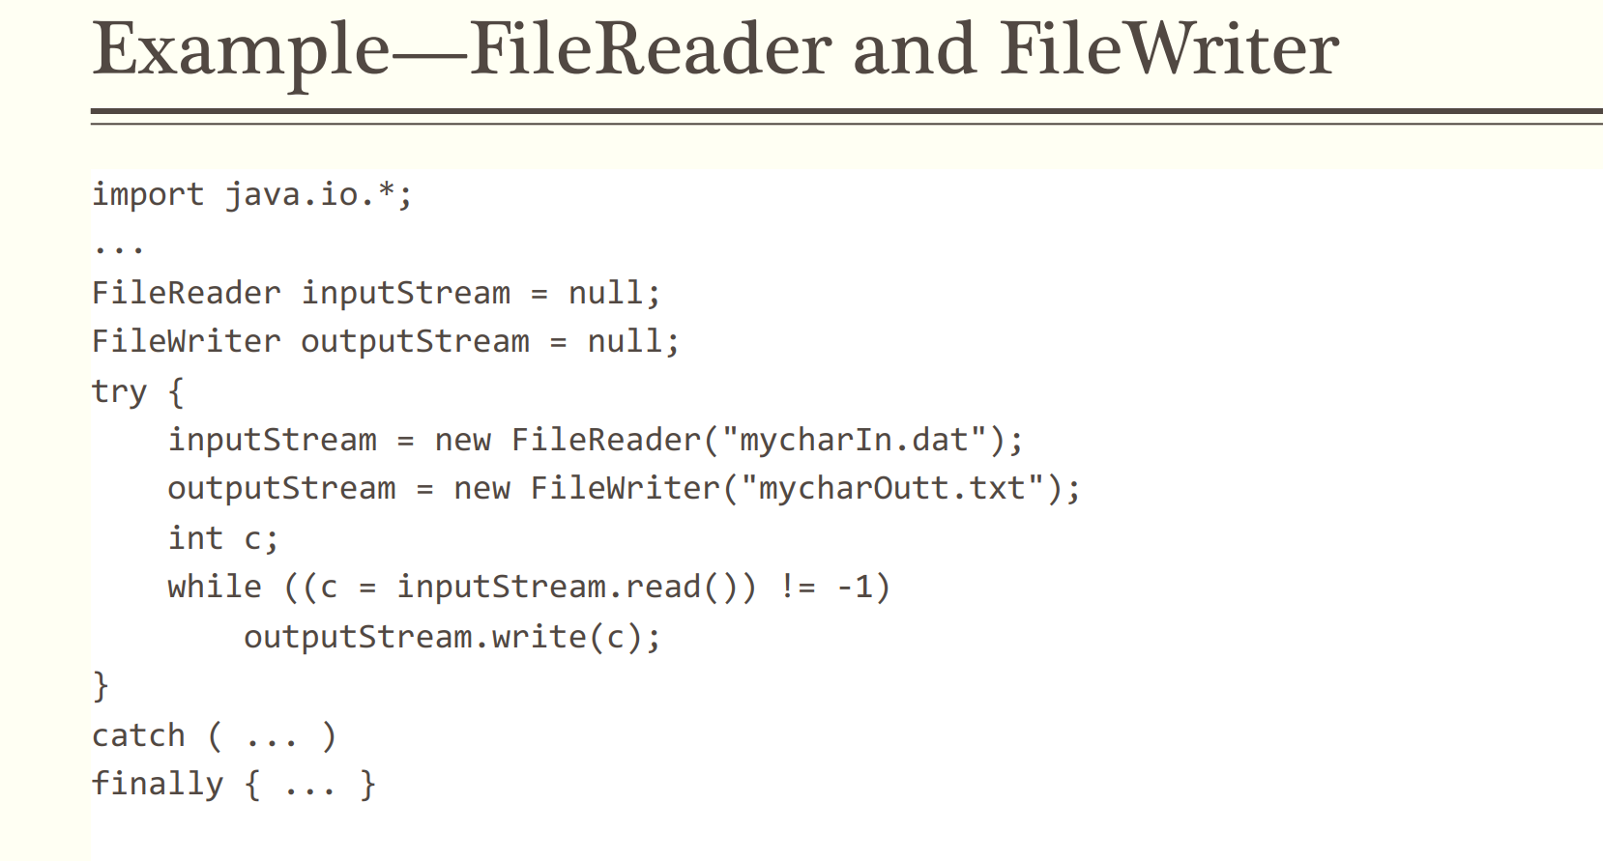

Slide 15
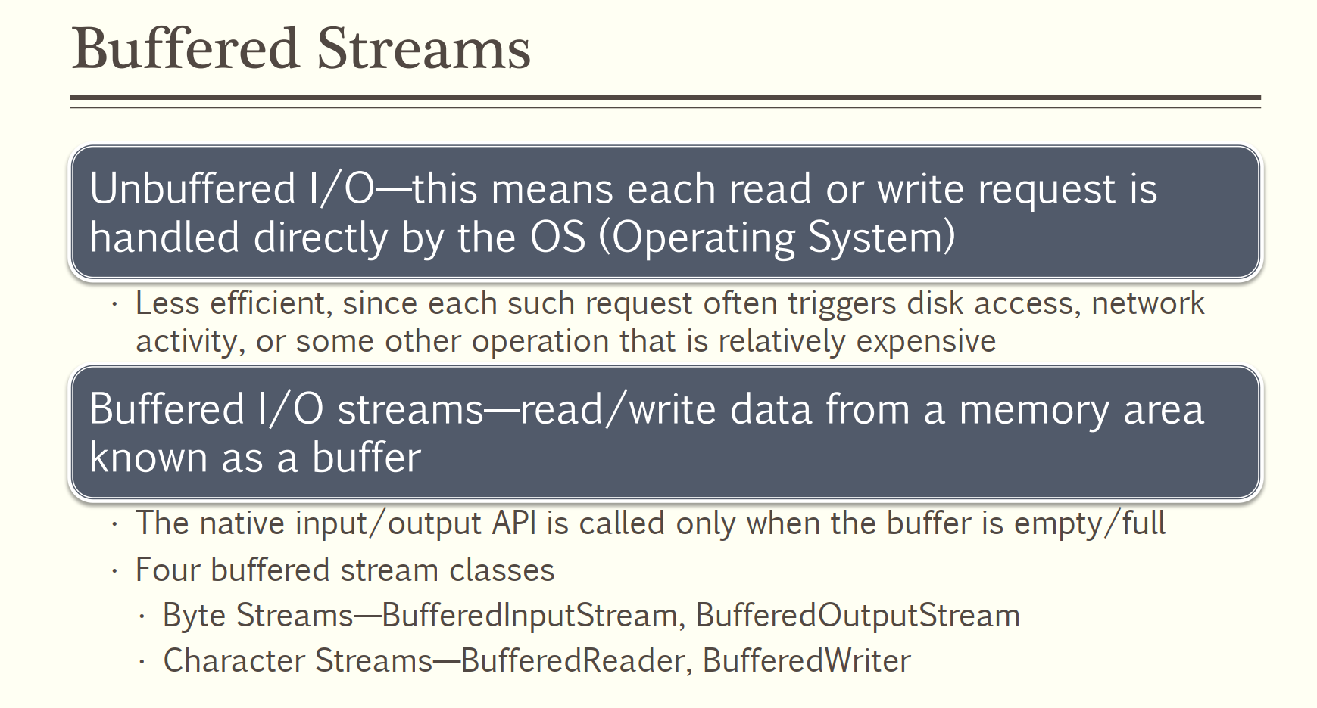

Slide 16
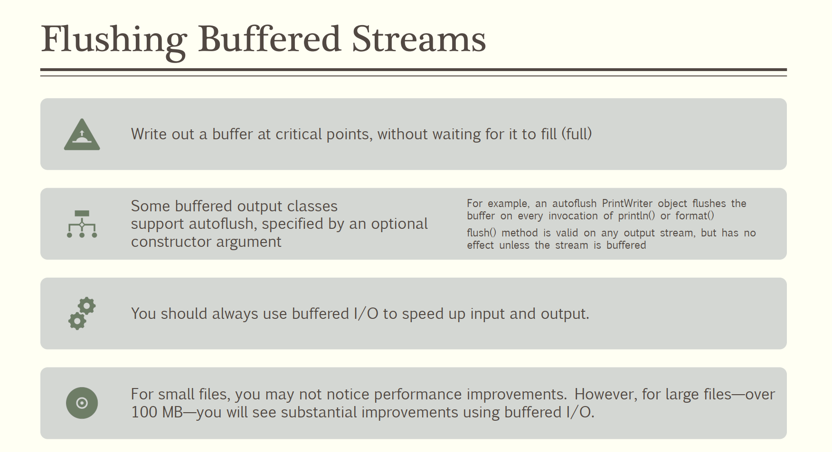

Slide 17
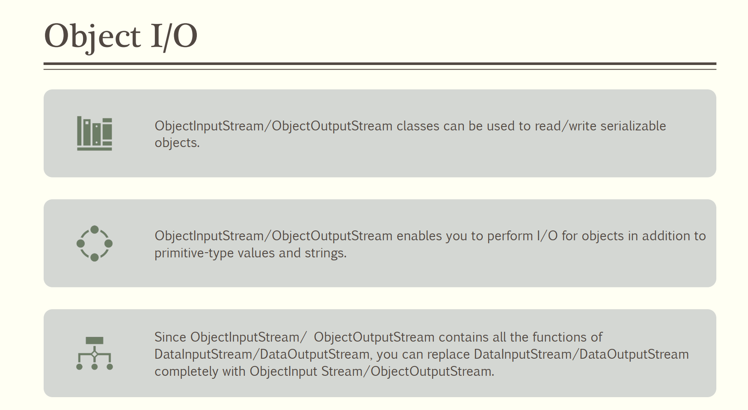

Slide 18
